Slide 1
Docit Information Management
Presentation by
Michael Feingold
Digital Onesource Consulting Solutions
www.digitalonesource.net

Slide 2
The Document Challenges in the Modern Office
Where do they come from?
Where do you keep them?
Snail Mail
E-Mail
Printers and Copiers
Customers
Accounting
Employees and HR Docs
Vendors
Government
File Cabinets
Off-site Storage
Local PC
Local Servers
Local NAS Devices
The Basement?

Slide 3
The Document Challenges in the Modern “New Norm” Office
Where do you keep them?
Post Covid Business World
File Cabinets---
Cost of Space
Labor Cost $$$ to Get a Document and Return it
Documents Not Returned to Cabinet
Documents Removed
Fire and Flood Disaster Recovery
Off-site Storage—Cost of Service $$$
Local PC– Shared or not Shared
Local Servers- Cost and Maintenance $$$
Local NAS Devices- Cost and Maintenance $$$
Real Estate Space Reduction
Remote Workers
Reduced Headcount
Mobile Workforce
Printing and Copying Costs $$$
How are Documents Shared?
How do You Access Them?
How do You Find Them?
How Long Does that Take? $$$

Slide 4
What is DocIt Information Management System?
DocIt is the Central Management Depository of all your
Business Related Documents
For Local, Remote, or Mobile Employees to Access Information
from Anywhere on Any Storage Source.
What Documents?
Contracts
Employment Records
Invoices
Purchase Orders
Emails and Email Attachments
Correspondence Letters
Memos
Bills of Lading
Shipping Records
Medical Records and more

Slide 5
How is it Done?
DocIt Consists of Several Customizable Software Products That Integrate with Each other Without Being a Proprietary Product
We have Several Core Components
DocIt is the Indexing and Retrieval Desktop Application
DocIt E-Notify Provides a widget in the task Bar for Notification that the End user Has New Documents to Review
DocIt Print xPort Provides a “Digital Printer” directly into the Pre-indexing Folder to Be Indexed (Elimination of Paper Printing and Copier Click charges)
DocIt Imaging Viewer Provides Date Stamping, Note Stamping, Hyperlinks to Other Documents, Page Reordering,
DocIt Scan Routing Provides Automated Workflows From Your Digital Copier, Laptop, Desktop, or E-mail Platform
Contracts
Employment Records
Invoices
Purchase Orders
Emails and Email Attachments
Correspondence Letters
Memos
Bills of Lading
Shipping Records
Medical Records and more

Slide 6
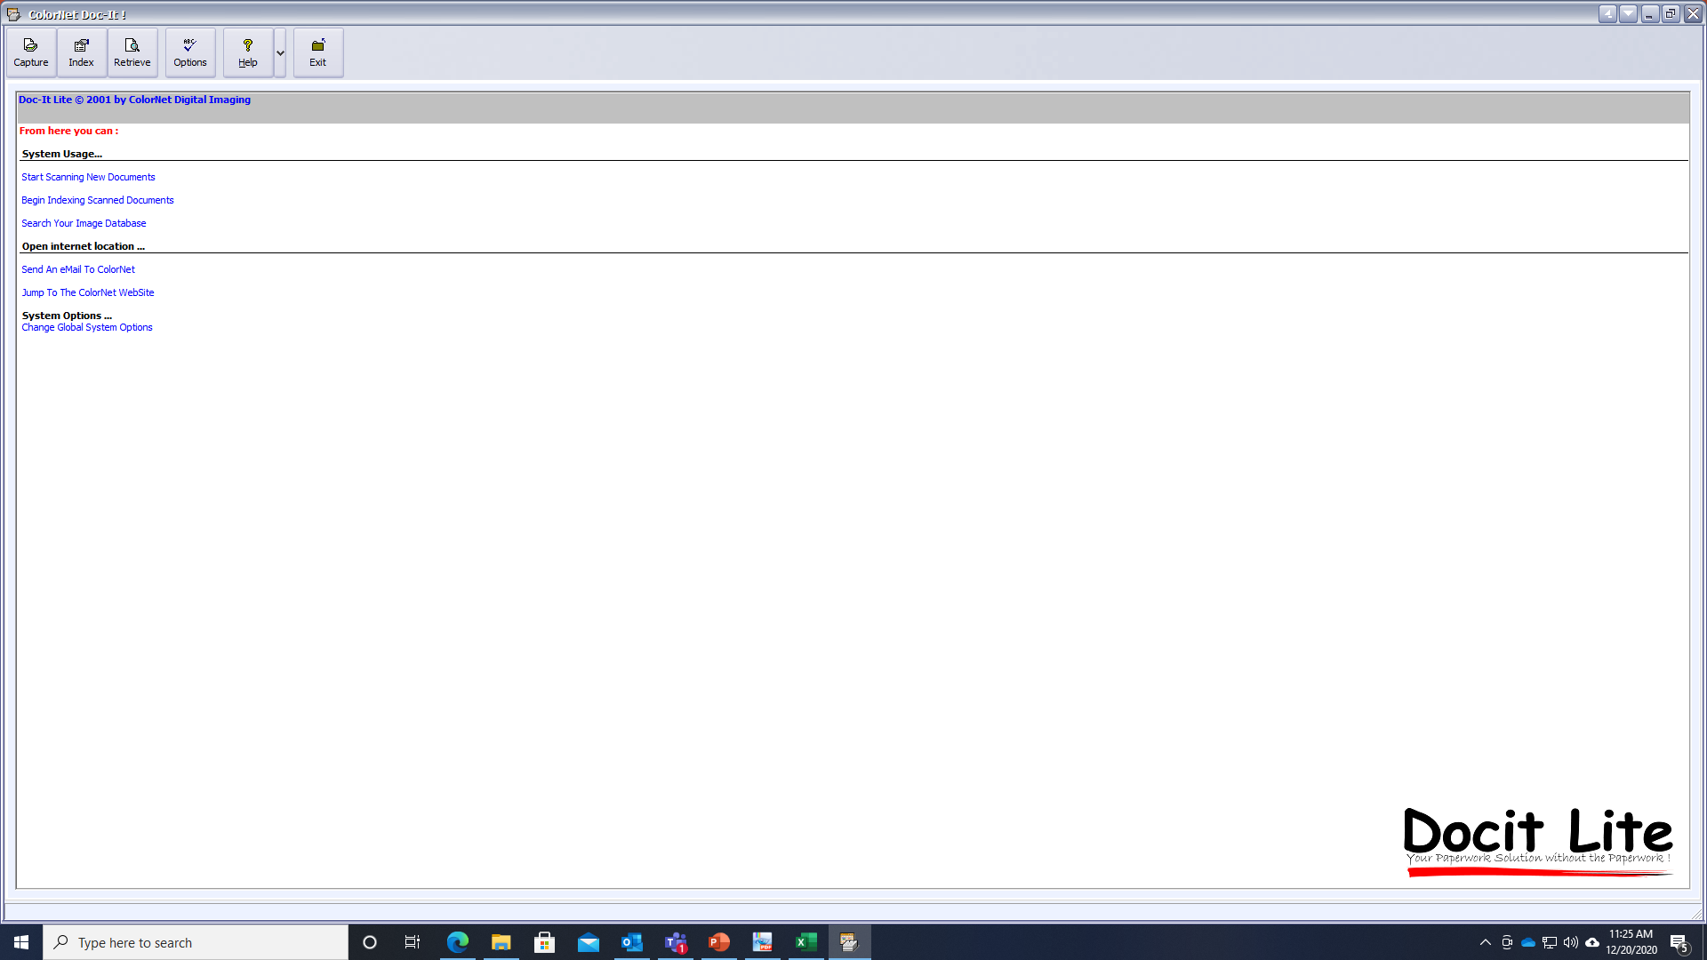
DocIt is the Indexing and Retrieval Desktop Application

Slide 7
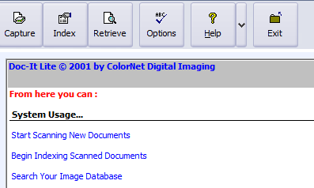
Capture: Used for Local Scanner or Automatically Capture from Network ”Watch” Folder
Index: Assigning Your Metadata- You decide on Field Structure for Naming
Retrieve: Enter Search Information with Partial or Complete Words, Names, Dates, Numbers, or Keywords, Etc.
Options: Used for Setting up Program and Directories.

Slide 8
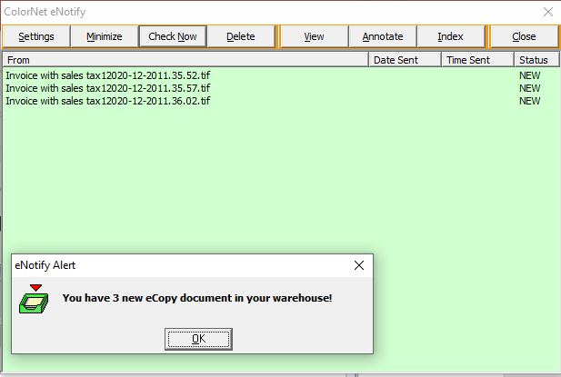
DocIt E-Notify Provides a widget in the task Bar for Notification that the End user Has New Documents to Review
You can View, Annotate, and Index Right from this screen as well. eNotify runs in the background on your task bar and only shows when there are new documents in your preindex folder

Slide 9
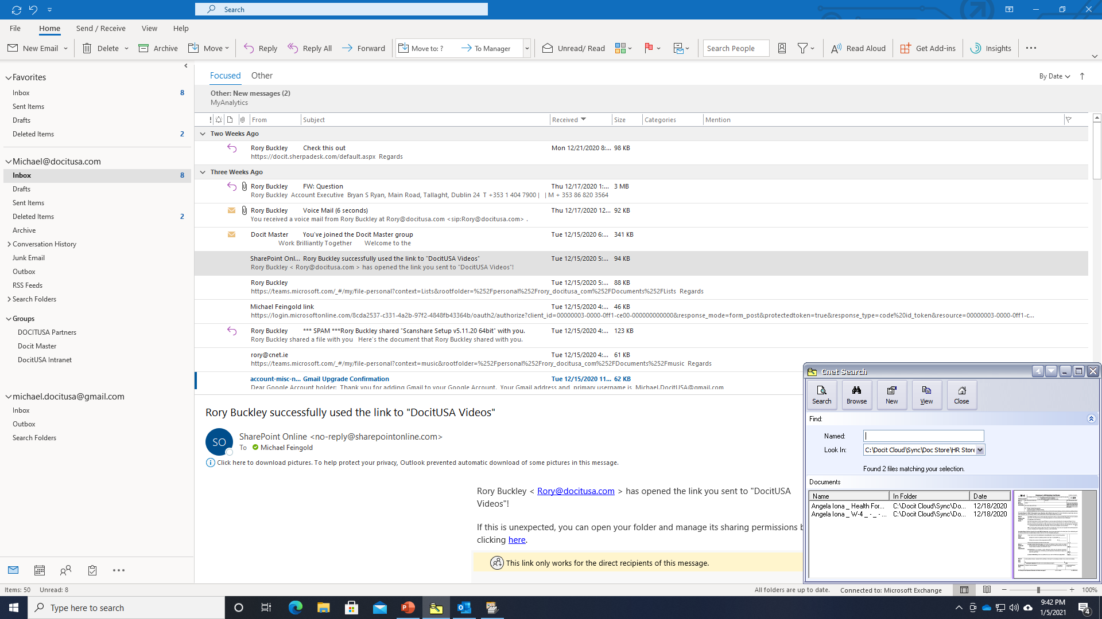
DocIt E-Search Provides a Reduced Screen for Docking on your Desktop Without Interrupting Your Workflow and being able to search documents, without running the program!
You can Search, View, and Annotate Right from this screen as well.

Slide 10
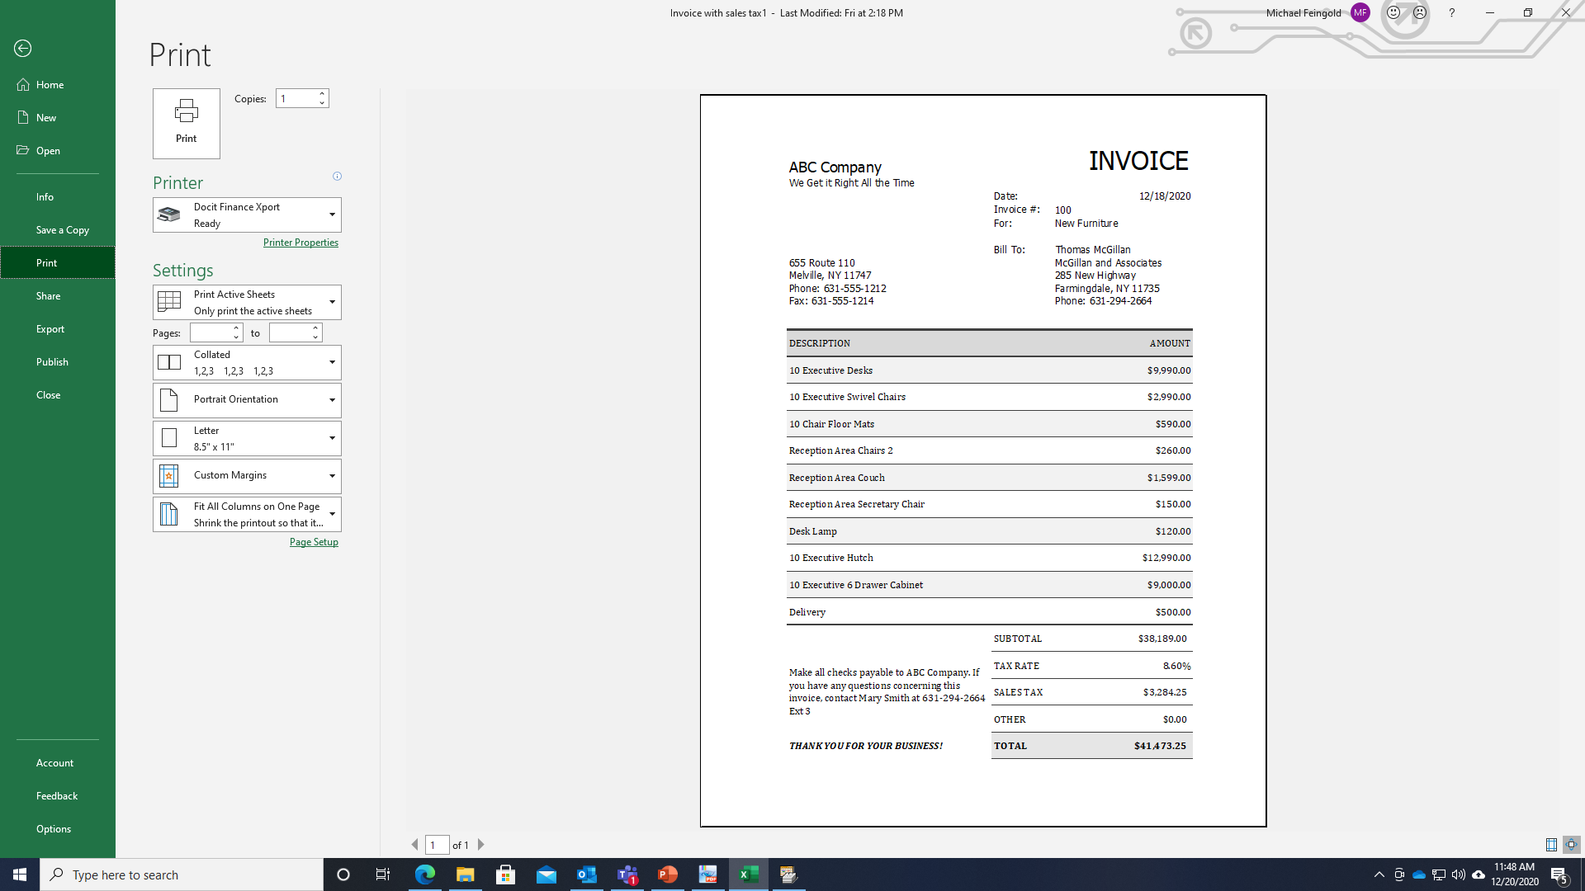
DocIt Print xPort Provides a “Digital Printer” directly into the Pre-indexing Folder to Be Indexed (Elimination of Paper Printing and Copier Click charges)
Digital Virtual Printer Output to
Preindex Folder

Slide 11
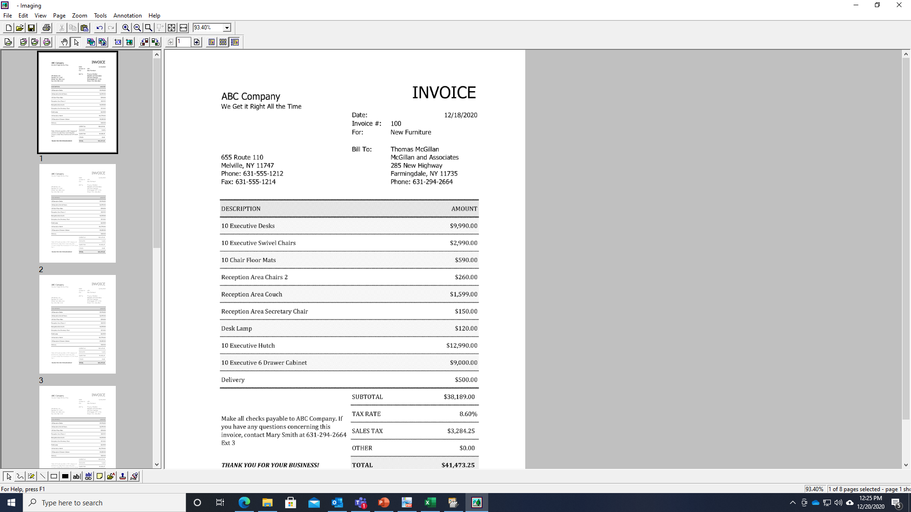
DocIt Imaging Viewer Provides Page Annotation, Page Re-Ordering, Hyperlinks to Other documents, Date Stamping, Image Stamping, Send Email, and more

Slide 12
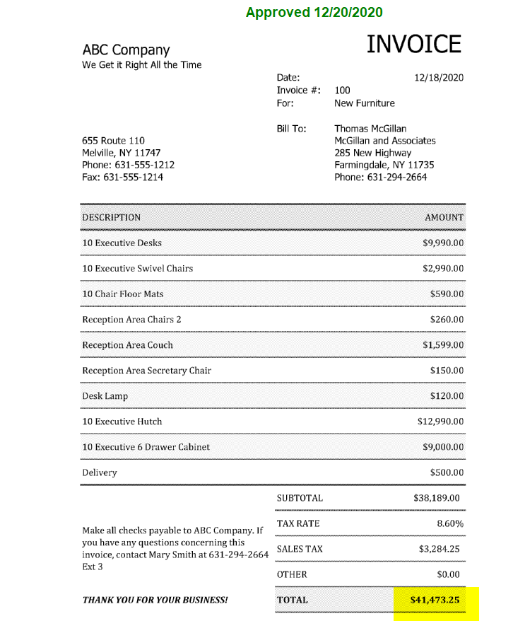
You can See Here that the Image Stamp show approved and the highlighted amount!

Slide 13
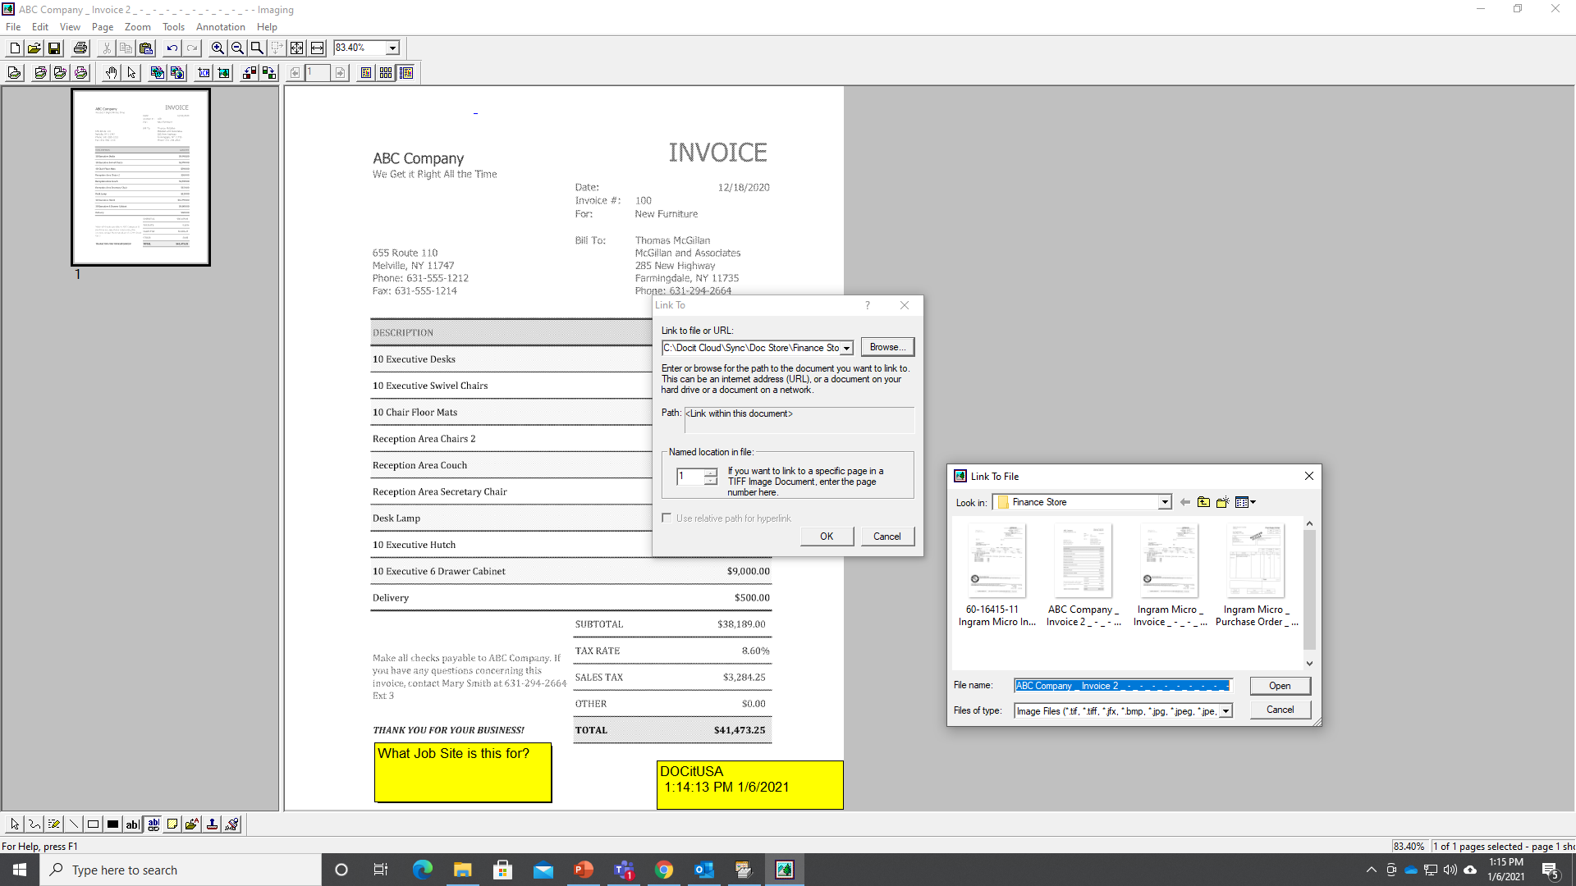
You can also add other stamps such as date and time, initials, sticky notes, approvals, custom text, hyperlinks to other documents (invoice against P.O., ie) and more!

Slide 14
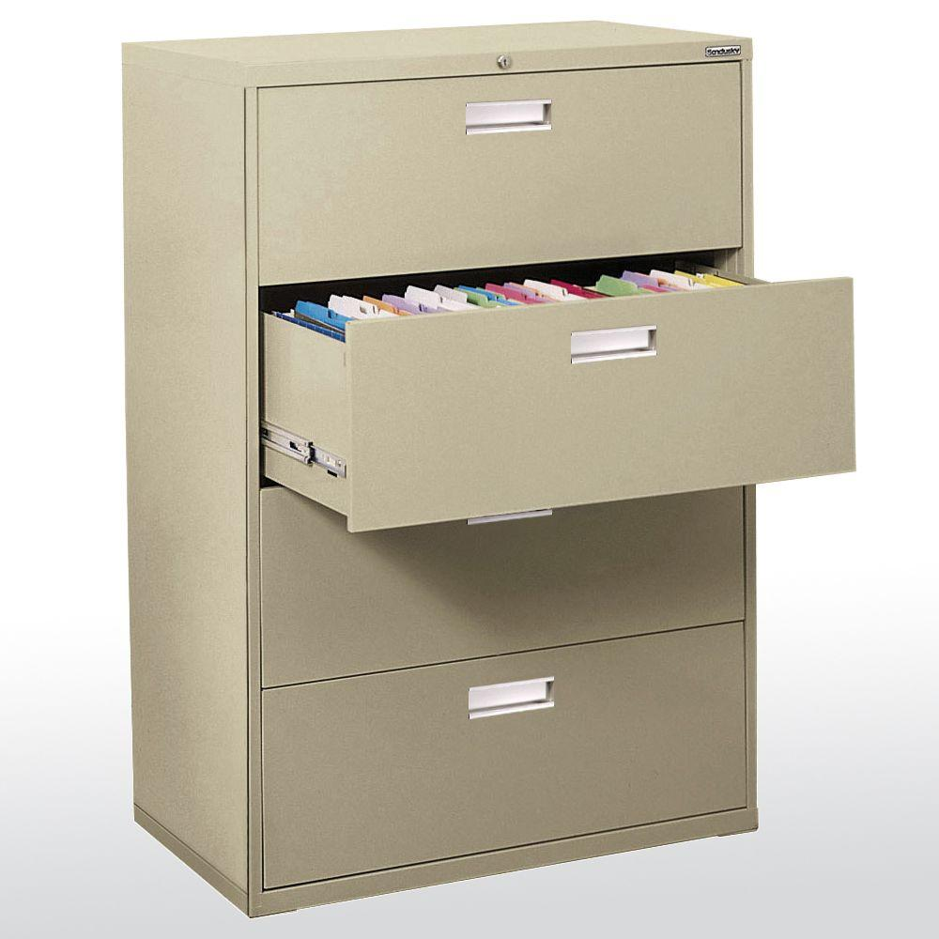
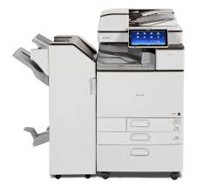
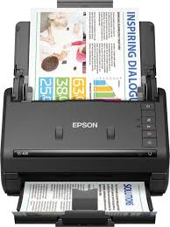
The Transformation for Your Business in the Modern World using the current technology you most likely already have!
From This!
And this
And this
To:

Slide 15
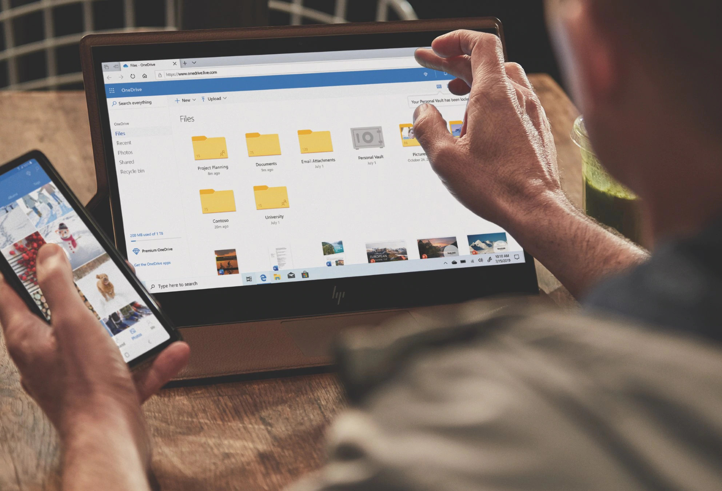
To The Modern World Using Modern Technology and Apps That All Employees Use Everyday…
Accessible from Dropbox, OneDrive, Google Drive, Sharepoint, Private Cloud, Etc.
Retrieve Documents from Smartphone, Laptop, Tablet Anywhere, Anytime!

Slide 16
Thank You… For a Live Demo or For More Information Please Contact:
United States
Michael Feingold
Michael@docitusa.com
888.502.5092 Ext 3
Europe
Rory Buckley
Rory@docitusa.com
0035318665611

