Slide 1
ATTENTION PRESENTERS
We have left space for you to add your own information title slide (page 2). You can add your name, title, company and logo.
Run through in “slide show” mode - there are many complex slide builds.
Finally, remember to delete this slide before you present.
Notes:
To insert a new slide with this template, go to the Home tab (up top), click New Slide and select the one that says Title and Content.

Slide 2
Powering education for next-generation leaders
Presenter’s Name Title Company Name
Insert partner logo here
Notes:
Hello, my name is <NAME> with <INSERT YOUR COMPANY NAME>, your current Eaton Power Management Solutions Provider. Thank you for giving us this opportunity today. In this presentation, I’ll be focusing specifically on helping you meet the needs of next-generation learners and leaders as well as showing you how power and power management solutions from <INSERT YOUR COMPANY NAME> and Eaton can deliver the reliability and performance demanded by today’s educational environments. After all, downtime isn’t an option for student or teachers.
Tips:
Title on this slide should be kept short.
Transparency bar is separate piece behind text. Please copy and paste the one in this slide to re-create.
Headlines should be set with an initial cap (sentence case) and the rest in lower case. Only product names or acronyms in the headline should begin with a capital letter.

Slide 3
Understanding trends and challenges
Digital Assessments / Content
Security
Blended / Distance Learning
Flipped Classrooms
Computing and mobility
BYOD

Slide 4
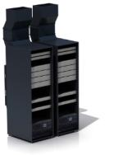
Keeping schools connected
Maintaining 24/7 connection demands an intelligent power infrastructure to avoid any single point of failure within the chain
Eaton UPS eRate Category 2 eligible UPS ensure mandatory uptime
Central office server room
Onsite school data closet
Front office and computer labs

Slide 5
Always-on infrastructure
The ongoing shift in how technology is used in classrooms is creating new challenges for IT administrators.
Expanded mobility and access
Higher quality instruction at reduced costs
Increased safety and security
Enhanced communication capabilities

Slide 6
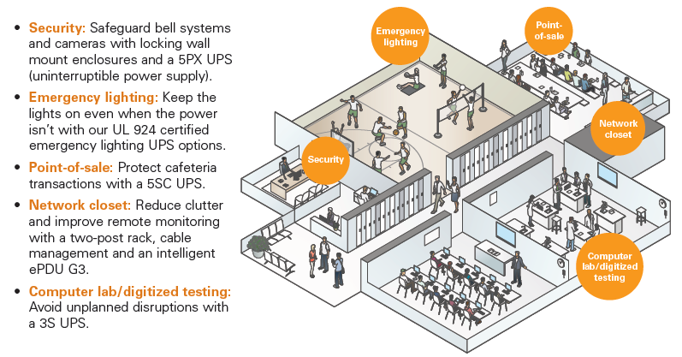
A solution for every application
Safe, reliable and efficient solutions that help schools do more with less

Slide 7
Eaton has you covered
Our comprehensive portfolio provides everything from blanking panels to virtualized power management software to 24/7 field service support, enabling you to implement an integrated risk-averse solution.
Organize
Protect
Manage
Open-frame racks
Wall mount enclosures
Rack shelf
Cable managers
Overhead cable tray
Basic rack PDU
Automatic transfer switch
Rack mount UPS
Extended battery module
Maintenance bypass module
Water and smoke sensors
UPS service
Environmental rack monitor and probe
Intelligent rack PDU
Power management software

Slide 8
Integration where it matters
Eaton is the industry leader when it comes to virtualized integration
Notes:
Eaton is the industry leader when it comes to virtualized integration.

Slide 9
“All of the others say their software integrates into VMware, “but when challenged and asked to demonstrate that in house, they couldn’t do it. Eaton was the only one who could deliver.”
- Tom McNinch, director of IT
Washington Unified School District
Intelligent Power Manager
9390
5PX
ePDUs
Service
Download the story.

